Slide 1
Data Crunching & Analysis
MovieLens 1M Dataset

Slide 2
What is Data Crunching
Data crunching is a upstream process of data analysis which helps to make a data format on which data analysis would be easier and efficient.
The term crunched data therefore refers to data that has already been imported and processed in a system

Slide 3
The Movielens Dataset
GroupLens Research provides a number of collections of movie ratings data collected from users of MovieLens in the late 1990s and early 2000s
The dataset has following tables and attributes:
users = (user_id, gender, age, occupation, zip)
ratings = (user_id, movie_id, rating, timestamp)
movies = (movie_id, title, genres)

Slide 4
Crunching the Data Tables
There are three tables and if we want to analyze, say gender based rating analysis then it is not possible without combining.
This combining step can be called data wrangling or crunching.
The merge function of pandas library is used to get the task done.

Slide 5
Data Analysis
The following analysis have been done on the dataset:
Mean rating according to Gender
Movies received at least 250 users’ ratings
Sorted by male & female of these mean rating (movies receiving at least 250 counts) and their trend.
Dependency of users’ Gender and Rating

Slide 6
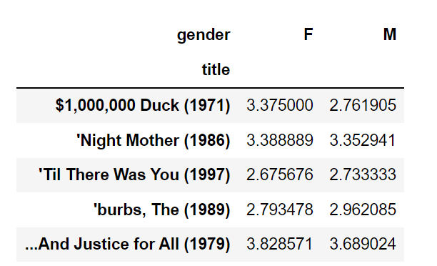
Mean rating according to Gender
Figure 1: Mean rating of movies according to Gender

Slide 7
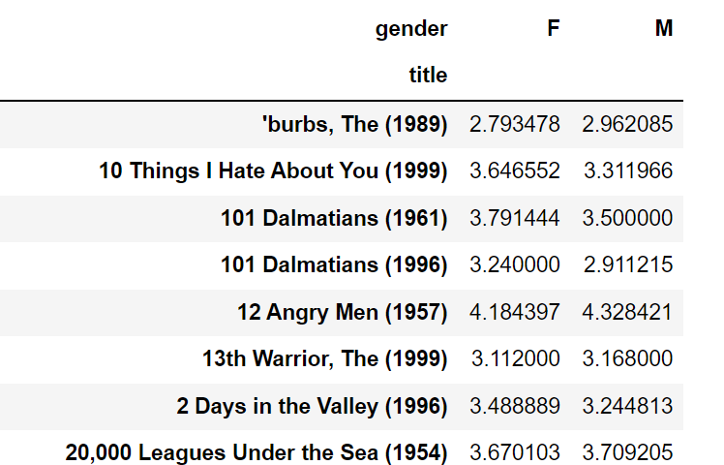
Movies received at least 250 ratings
Figure 2 : A part of the movies that have been received minimum 250 ratings

Slide 8
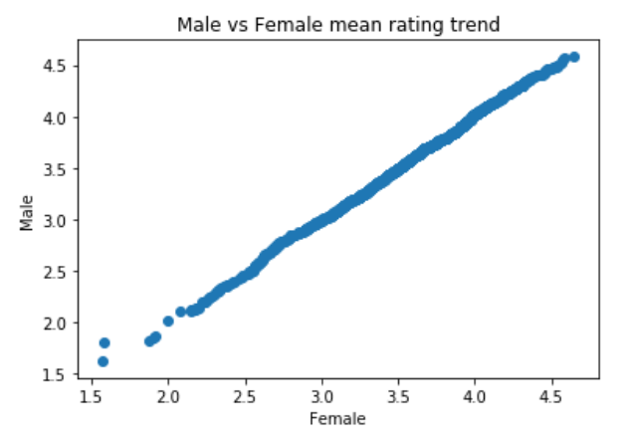
Mean Rating sorted by Male & Female Trend:
Figure 3 : Trend of rating based on gender

Slide 9
Dependency of Rating on Gender
The two variables are categorical
The chi-square test is good for dependency test or significance test of such variables
It has been found out that the two variables are dependent

Slide 10
Thank You

